Slide 1
Bayesian Learning
Provides practical learning algorithms
  Naïve Bayes learning
  Bayesian belief network learning
  Combine prior knowledge (prior probabilities)
Provides foundations for machine learning
  Evaluating learning algorithms
  Guiding the design of new algorithms
  Learning from models : meta learning

Slide 2
Bayesian Classification: Why?
Probabilistic learning: Calculate explicit probabilities for hypothesis, among the most practical approaches to certain types of learning problems
Incremental: Each training example can incrementally increase/decrease the probability that a hypothesis is correct. Prior knowledge can be combined with observed data.
Probabilistic prediction: Predict multiple hypotheses, weighted by their probabilities
Standard: Even when Bayesian methods are computationally intractable, they can provide a standard of optimal decision making against which other methods can be measured

Slide 3
Difficulty:
  They typically require initial knowledge of many probabilities.
  When these probabilities are not known in advance they are often estimated based on background knowledge, previously available data, and assumptions about the form of the underlying distributions.
  The significant computational cost required to
  determine the Bayes optimal hypothesis in the general case

Slide 4
BAYES THEOREM
One way to specify the best hypothesis is to say that we demand the most probable hypothesis, given the data D plus any initial knowledge about the prior probabilities
of the various hypotheses in H
Bayes theorem provides a direct method for calculating such probabilities.
Bayes theorem is the cornerstone of Bayesian learning methods because it provides a way to calculate the posterior probability P(h|D), from the prior probability P(h), together with P(D) and P(D|h).

Slide 5
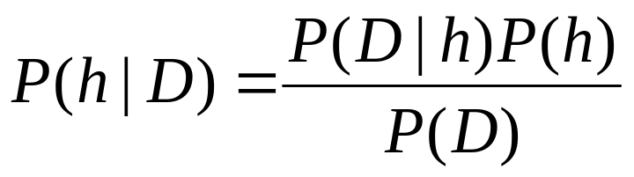

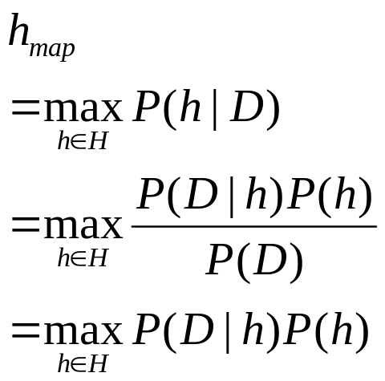
Basic Approach
Bayes Rule:
P(h) = prior probability of hypothesis h
P(D) = prior probability of training data D
P(h|D) = probability of h given D (posterior density )
P(D|h) = probability of D given h (likelihood of D given h)
The Goal of Bayesian Learning: the most probable hypothesis given the training data (Maximum A Posteriori hypothesis )

Slide 6
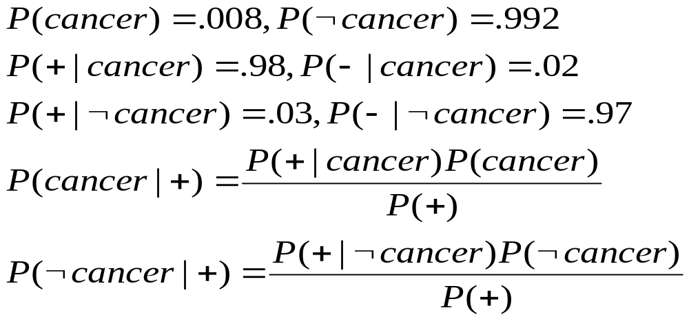
An Example
Does patient have cancer or not?
A patient takes a lab test and the result comes back positive. The test returns a correct positive result in only 98% of the cases in which the disease is actually present, and a correct negative result in only 97% of the cases in which the disease is not present. Furthermore, .008 of the entire population have this cancer.

Slide 7
MAXIMUM LIKELIHOOD AND LEAST-SQUARED ERROR HYPOTHESES
Consider the problem of learning a continuous-valued target function .
Any learning algorithm that minimizes the squared error between the output hypothesis predictions and the training data will output a maximum likelihood hypothesis .
The significance of this result is that it provides a Bayesian justification .

Slide 8
MAXIMUM LIKELIHOOD AND LEAST-SQUARED ERROR HYPOTHESES
Example:The problem faced by learner L is to learn an unknown target function f : X -> R drawn from H.
X-instance space ,R-Real value, H-hypothesis space.
A set of m training examples is provided, where the target value of each example is corrupted by random noise .
The task of the learner is to output a maximum likelihood hypothesis, or, equivalently, a MAP hypothesis assuming all hypotheses are equally probable a priori.
The dashed line in the following figure corresponds to the hypothesis hML with least-squared training error, hence the maximum likelihood hypothesis.

Slide 9
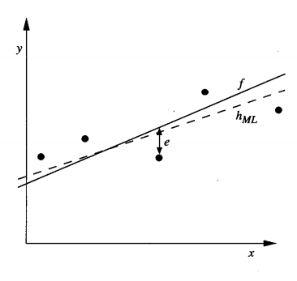

Slide 10

MAXIMUM LIKELIHOOD AND LEAST-SQUARED ERROR HYPOTHESES
The two basic concepts from probability theory prove that a hypothesis that minimizes the sum of squared errors
is also a maximum likelihood hypothesis for continuous functions.
  Probability density:To discuss probabilities over continuous variables we must introduce probability densities as finite probability cannot work.
  The random noise variable e is generated by a Normal
  probability distribution.

Slide 11


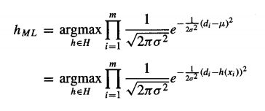

MAXIMUM LIKELIHOOD AND LEAST-SQUARED ERROR HYPOTHESES
Derivation of hML

Slide 12


MAXIMUM LIKELIHOOD AND LEAST-SQUARED ERROR HYPOTHESES
First term is independent oh h so remove.
Maximizing this negative quantity is equivalent to minimizing the corresponding positive quantity.

Slide 13
Contd..
The above equation shows that the maximum likelihood hypothesis the one that minimizes the sum of the squared errors between the observed training values di and the hypothesis predictions h(xi).
This approach of working with the log likelihood is common to many Bayesian analyses, because it is often more mathematically tractable than working directly with the likelihood.

Slide 14
Limitations
  The above analysis considers noise only in the target value of the training example and does not consider noise in the attributes describing the instances themselves.

Slide 15

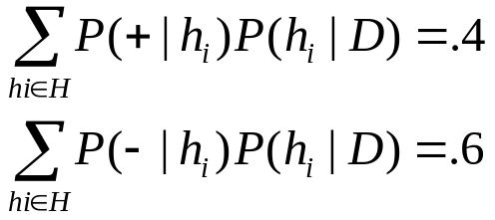
Bayes Optimal Classifier
Question: Given new instance x, what is its most probable classification?
Hmap(x) is not the most probable classification!
Example: Let P(h1|D) = .4, P(h2|D) = .3, P(h3 |D) =.3
    Given new data x, we have h1(x)=+, h2(x) = -, h3(x) = -
    What is the most probable classification of x ?
Bayes optimal classification:
Example:
P(h1| D) =.4, P(-|h1)=0, P(+|h1)=1
P(h2|D) =.3, P(-|h2)=1, P(+|h2)=0
P(h3|D)=.3, P(-|h3)=1, P(+|h3)=0

Slide 16
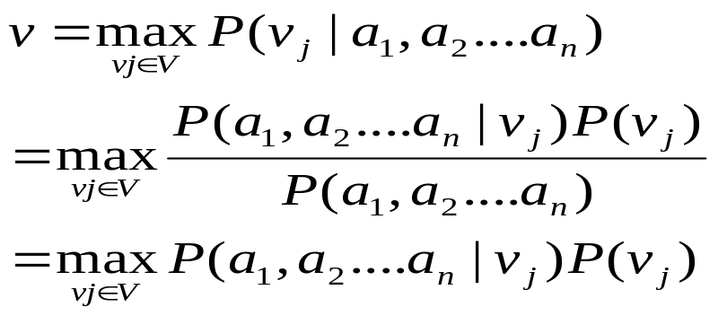
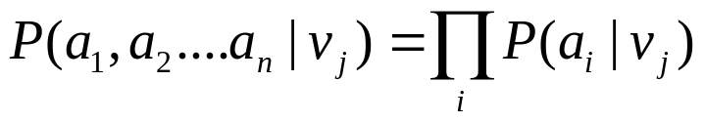
Naïve Bayes Learner
Assume target function f: X-> V, where each instance x described by attributes <a1, a2, …., an>. Most probable value of f(x) is:
Naïve Bayes assumption:
(attributes are conditionally independent)

Slide 17
Bayesian classification
The classification problem may be formalized using a-posteriori probabilities:
P(C|X) = prob. that the sample tuple X=<x₁,…,x_{k}> is of class C.
E.g. P(class=N | outlook=sunny,windy=true,…)
Idea: assign to sample X the class label C such that P(C|X) is maximal

Slide 18
Estimating a-posteriori probabilities
Bayes theorem:
P(C|X) = P(X|C)·P(C) / P(X)
P(X) is constant for all classes
P(C) = relative freq of class C samples
C such that P(C|X) is maximum =
C such that P(X|C)·P(C) is maximum
Problem: computing P(X|C) is unfeasible!

Slide 19
Naïve Bayesian Classification
Naïve assumption: attribute independence
P(x₁,…,x_{k}|C) = P(x₁|C)·…·P(x_{k}|C)
If i-th attribute is categorical:
P(x_{i}|C) is estimated as the relative freq of samples having value x_{i} as i-th attribute in class C
If i-th attribute is continuous:
P(x_{i}|C) is estimated through a Gaussian density function
Computationally easy in both cases

Slide 20
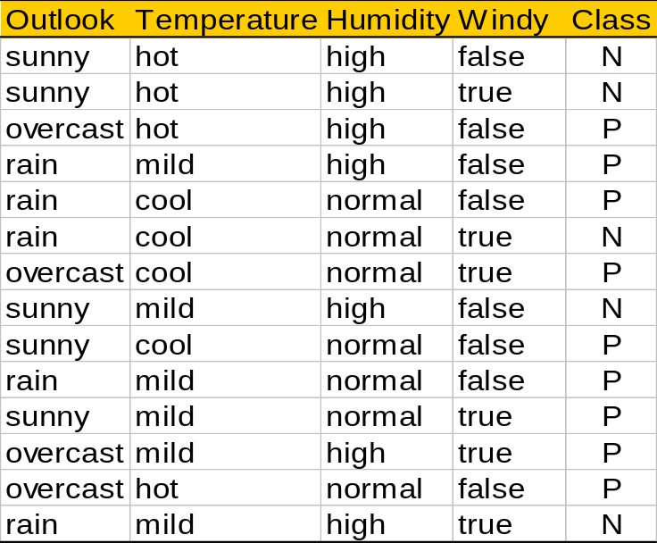
Play-tennis example: estimating P(x_{i}|C)
outlook
P(sunny|p) = 2/9 | P(sunny|n) = 3/5
P(overcast|p) = 4/9 | P(overcast|n) = 0
P(rain|p) = 3/9 | P(rain|n) = 2/5
temperature
P(hot|p) = 2/9 | P(hot|n) = 2/5
P(mild|p) = 4/9 | P(mild|n) = 2/5
P(cool|p) = 3/9 | P(cool|n) = 1/5
humidity
P(high|p) = 3/9 | P(high|n) = 4/5
P(normal|p) = 6/9 | P(normal|n) = 2/5
windy
P(true|p) = 3/9 | P(true|n) = 3/5
P(false|p) = 6/9 | P(false|n) = 2/5
P(p) = 9/14
P(n) = 5/14

Slide 21
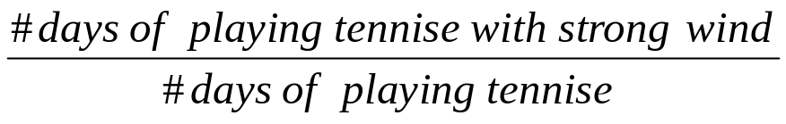
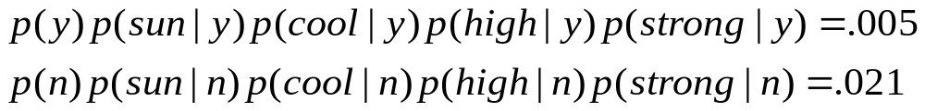
Example : Naïve Bayes
Predict playing tennis in the day with the condition <sunny, cool, high, strong> (P(v| o=sunny, t= cool, h=high w=strong)) using the following training data:
Day Outlook Temperature Humidity Wind Play Tennis
1 Sunny Hot High Weak No
2 Sunny Hot High Strong No
3 Overcast Hot High Weak Yes
4 Rain Mild High Weak Yes
5 Rain Cool Normal Weak Yes
6 Rain Cool Normal Strong No
7 Overcast Cool Normal Strong Yes
8 Sunny Mild High Weak No
9 Sunny Cool Normal Weak Yes
10 Rain Mild Normal Weak Yes
11 Sunny Mild Normal Strong Yes
12 Overcast Mild High Strong Yes
13 Overcast Hot Normal Weak Yes
14 Rain Mild High Strong No
we have :

Slide 22
The independence hypothesis…
… makes computation possible
… yields optimal classifiers when satisfied
… but is seldom satisfied in practice, as attributes (variables) are often correlated.
Attempts to overcome this limitation:
  Bayesian networks, that combine Bayesian reasoning with causal relationships between attributes
  Decision trees, that reason on one attribute at the time, considering most important attributes first

Slide 23

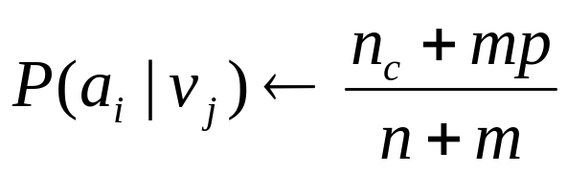
Naïve Bayes Algorithm
Naïve_Bayes_Learn (examples)
for each target value vj
estimate P(vj)
for each attribute value ai of each attribute a
estimate P(ai | vj )
Classify_New_Instance (x)
Typical m-estimation of P(ai | vj) if nc=0
Where
n: examples with v=v; p is prior estimate for P(ai|vj)
nc: examples with a=ai, m is the weight to prior

Slide 24
An example: Learning to classify the text
We might wish to learn the target concept "electronic news articles that I find interesting“.
General setting:
  Consider an instance space X consisting of all possible text documents .
  The task is to learn from these training examples to predict the target value for subsequent text documents.
  The target values are like and dislike to indicate the two classes.

Slide 25
Bayesian Belief Networks
Naïve Bayes assumption of conditional independence too restrictive
But it is intractable without some such assumptions
Bayesian Belief network (Bayesian net) describe conditional independence among subsets of variables (attributes): combining prior knowledge about dependencies among variables with observed training data.
Bayesian Net
  Node = variables
  Arc = dependency
  DAG, with direction on arc representing causality
  To each variables A with parents B1, …., Bn there is attached a conditional probability table P (A | B1, …., Bn)

Slide 26
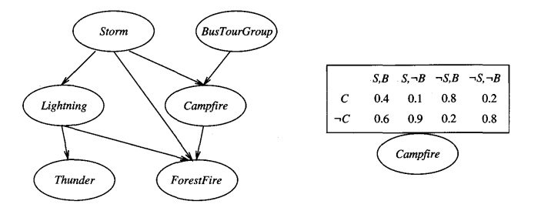
Example

Slide 27
Bayesian Belief Networks
A Bayesian belief network describes the probability distribution over a set of variables.
Consider an arbitrary set of random variables Yl .. .Yn
then the joint space of the set of variables Y to be the cross product V(Yl) x V(Y2) x... V(Yn).
The probability distribution over this joint' space is called the joint probability distribution.
The conditional independence in bayesian belief network is
as follows

Slide 28
Bayesian Belief Networks
Let X , Y, and Z be three discrete-valued random variables.
We say that X is conditionally independent of Y given Z if
We commonly write the above expression in abbreviated form as P(X|Y, Z ) = P(X|Z).
Representation
Example

Slide 29
Bayesian Belief Networks
Age, Occupation and Income determine if customer will buy this product.
Given that customer buys product, whether there is interest in insurance is now independent of Age, Occupation, Income.
P(Age, Occ, Inc, Buy, Ins ) = P(Age)P(Occ)P(Inc)
P(Buy|Age,Occ,Inc)P(Int|Buy)
Current State-of-the Art: Given structure and probabilities, existing algorithms can handle inference with categorical values and limited representation of numerical values
Occ
Age
Income
Buy X
Interested in
Insurance

Slide 30
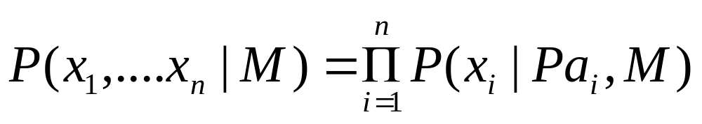
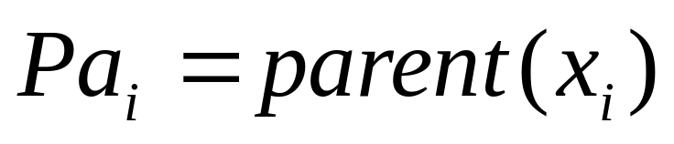
General Product Rule

Slide 31
Bayesian Belief Networks
Inference
  Exact inference of probabilities in general for an arbitrary Bayesian network is known to be NP-hard
  Numerous methods have been proposed for probabilistic inference in Bayesian networks .
  Monte Carlo methods provide approximate solutions by randomly sampling the distributions of the unobserved variables

Slide 32

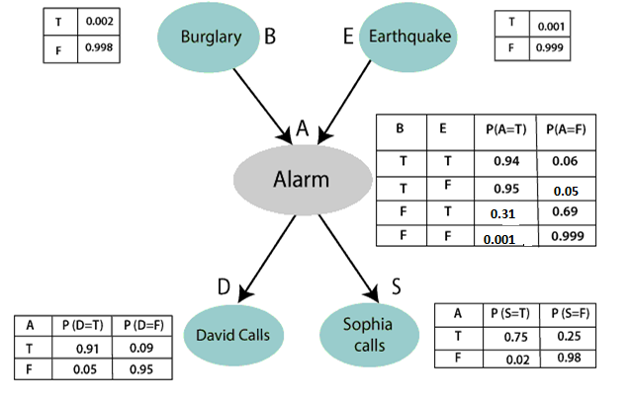
Example

Slide 33
Contd..
Calculate the probability that alarm has sounded, but there is neither a burglary, nor an earthquake occurred, and David and Sophia both called the Harry.
We can rewrite the above statement as
P(S, D, A, ¬B, ¬E)
P(S, D, A, ¬B, ¬E) = P (S|A) *P (D|A)*P (A|¬B ^ ¬E) *P (¬B) *P (¬E).
= 0.75* 0.91* 0.001* 0.998*0.999
= 0.00068045.

Slide 34
Bayesian Belief Networks
Learning Bayesian Belief Networks
  Settings
    The network structure might be given in advance, or it might have to be inferred from the training data.
    All the network variables might be directly observable in each training example, or some might be unobservable.
  If the network structure is given in advance and the variables are fully observable in the training examples, learning the conditional probability tables is straightforward.

Slide 35
Bayesian Belief Networks
The network structure is given but only some of the variable values are observable in the training data, the learning problem is more difficult.
Russell et al. (1995) propose a gradient ascent procedure that learns the entries in the conditional probability tables.
Searches through a space of hypotheses that corresponds to the set of all possible entries for the conditional probability tables.

Slide 36

Bayesian Belief Networks
Gradient Ascent Training of Bayesian Networks
  It maximizes P(D|h) by following the gradient of In P(D|h) with respect to the parameters that define the conditional probability tables of the Bayesian network.
  wijk denote the conditional probability that the network variable Yi will take on the value yi,
  given that its immediate parents Ui .

Slide 37
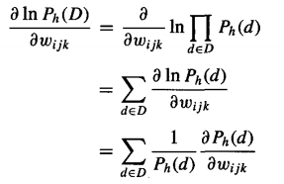
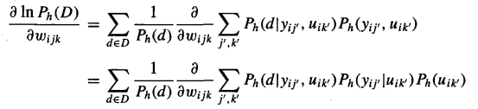
Bayesian Belief Networks
Derivation
  As d are drawn independently

Slide 38
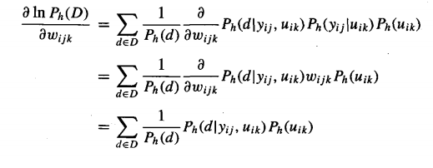
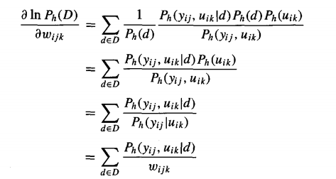
Bayesian Belief Networks

Slide 39

Bayesian Belief Networks
First we update each wijk by gradient ascent
This algorithm is guaranteed only to find some local optimum solution.
An alternative to gradient ascent is the EM
algorithm which also finds locally maximum likelihood solutions.

Slide 40
Bayesian Belief Networks
Learning the Structure of Bayesian Networks
  A heuristic search algorithm called K2 for learning network structure is used when the data is fully observable.
  It performs a greedy search that trades off network complexity for accuracy over the training data.
  Constraint-based approaches to learning Bayesian network structure have also been developed .
  These approaches infer independence and dependence relationships from the data, and then use these relationships to construct Bayesian networks.

